Slide 1

EDA – Analysis of AMCAT Data
By
Prudhvi Nath Thota
Intern Id:- IN1240634

Slide 2
About me
B.Tech(Hons)(Aerospace Engineering) from Hindustan Institute of Technology and Science (2018 – 2022) - 8.46 CGPA.
I want to learn Data Science which includes ML & DL so that, I can do masters in Artificial Intelligence.
Gmail:- prudhvinaththota@gmil.com
Github:- https://github.com/thotaprudhvinath
Linkedin:- https://www.linkedin.com/in/prudhvinath-thota-6697b81ab/

Slide 3
Agenda (This should be the PPT flow)
Business Problem and Use case domain understanding(If Required)
Objective of the Project
Web Scraping – Details (Websites, Processor you followed)
Summary of the Data
Exploratory Data Analysis:
Data Cleaning Steps
Data Manipulation Steps
Univariate Analysis Steps
Bivariate Analysis Steps
Key Business Question
Conclusion (Key finding overall)
Q&A Slide
Your Experience/Challenges working on Web Scraping – Data Analysis Project.

Slide 4
Domain Understanding
The dataset was released by Aspiring Minds from the Aspiring Mind Employment Outcome 2015 (AMEO). The study is primarily limited only to students with engineering disciplines. The dataset contains the employment outcomes of engineering graduates as dependent variables (Salary, Job Titles, and Job Locations) along with the standardized scores from three different areas – cognitive skills, technical skills and personality skills. The dataset also contains demographic features. The dataset contains around 40 independent variables and 4000 data points.

Slide 5
Column Description
ID: Unique identifier for each candidate.
UID: Another unique identifier for each candidate.
Salary: Continuous variable representing the annual CTC offered to the candidate (in INR).
DOJ: Date variable representing the date of joining the company.
DOL: Date variable representing the date of leaving the company.
Designation: Categorical variable representing the job designation offered.
Job City: Categorical variable representing the location of the job (city).
Gender: Categorical variable representing the candidate's gender.
DOB: Date variable representing the candidate's date of birth.
10percentage: Continuous variable representing the overall marks obtained in grade 10 examinations.
10board: Categorical variable representing the school board followed in grade 10.
12graduation: Date variable representing the year of graduation from senior year high school.
12percentage: Continuous variable representing the overall marks obtained in grade 12 examinations.

Slide 6
12board: Categorical variable representing the school board followed in grade 12.
CollegeID: Identifier for the college/university attended by the individual.
CollegeTier: Tier of the college/university attended.
Degree: Degree obtained by the individual.
Specialization: Field of specialization or major.
CollegeGPA: Grade Point Average (GPA) obtained during college/university.
CollegeCityID: Identifier for the city where the college/university is located.
CollegeCityTier: Tier of the city where the college/university is located.
CollegeState: State where the college/university is located.
GraduationYear: Year of graduation from college/university.
English: Score in AMCAT's English section.
Logical: Score in AMCAT's Logical section.
Quant: Score in AMCAT's Quantitative section.
Domain: Score in AMCAT's domain module.

Slide 7
ComputerProgramming: Score in AMCAT's Computer Programming section.
ElectronicsAndSemicon: Score in AMCAT's Electronics & Semiconductor Engineering section.
ComputerScience: Score in AMCAT's Computer Science section.
MechanicalEngg: Score in AMCAT's Mechanical Engineering section.
ElectricalEngg: Score in AMCAT's Electrical Engineering section.
TelecomEngg: Score in AMCAT's Telecommunication Engineering section
TelecomEngg: Score in AMCAT's Telecommunication Engineering section.
CivilEngg: Score in AMCAT's Civil Engineering section.
Conscientiousness: Score in AMCAT's conscientiousness trait section.
Agreeableness: Score in AMCAT's agreeableness trait section.
Extraversion: Score in AMCAT's extraversion trait section.
Neuroticism: Score in AMCAT's neuroticism trait section.
Openness_to_experience: Score in AMCAT's openness to experience trait section.

Slide 8
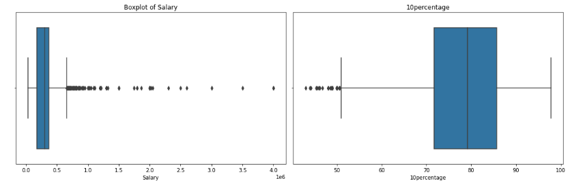
Finding the outliers in each numerical column
Box plot of Salary and 10percentage Columns
Observations :-
There are lot of outliers in the salary column, because 75th percentile is 3,70,000 and the max salary is 40lakhs.
The average salary of the employes is 3,07,700.

Slide 9
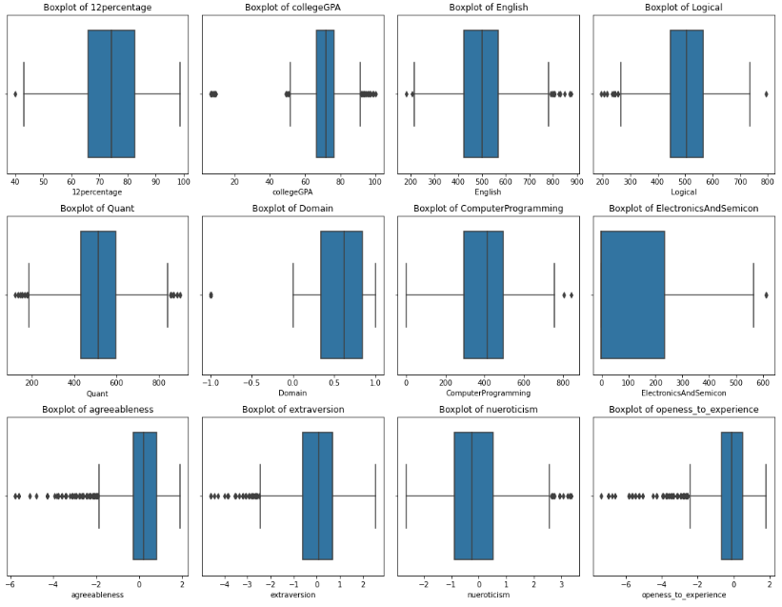
Observation:-
All the columns have outliers
Especially, agreeableness, extraversion,openess_to_experience,collegeGPA,English,Logical,Quant have maximum outliers.
12Percentage, Domain, Computer Programming, Electronics And Semicon have only one or two outliers.

Slide 10
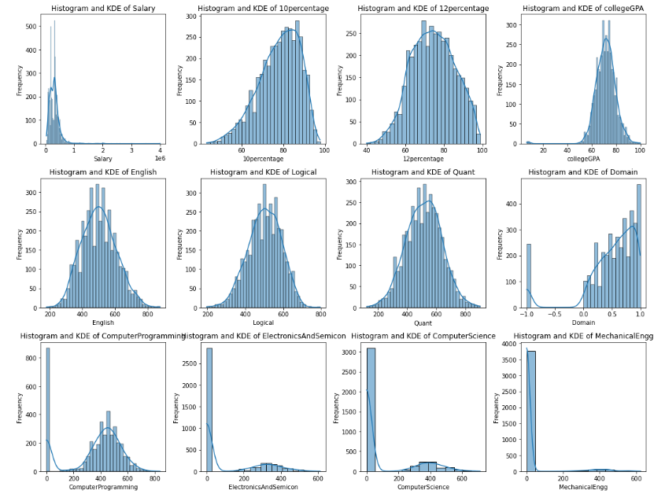
Probability and frequency distribution of each numerical column

Slide 11
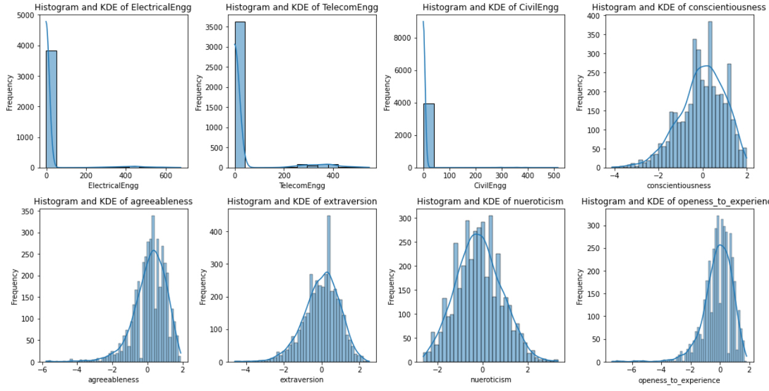
Observations:-
Maximum Students salary is below one lakhs.
Around 80% of the students performed well in both 10th and 12th as well as in Collage.
Also, knowledgeable in there respective Domain.
There score in English, Logical, Quant is averagely performed as like as there computer programming knowledge.

Slide 12
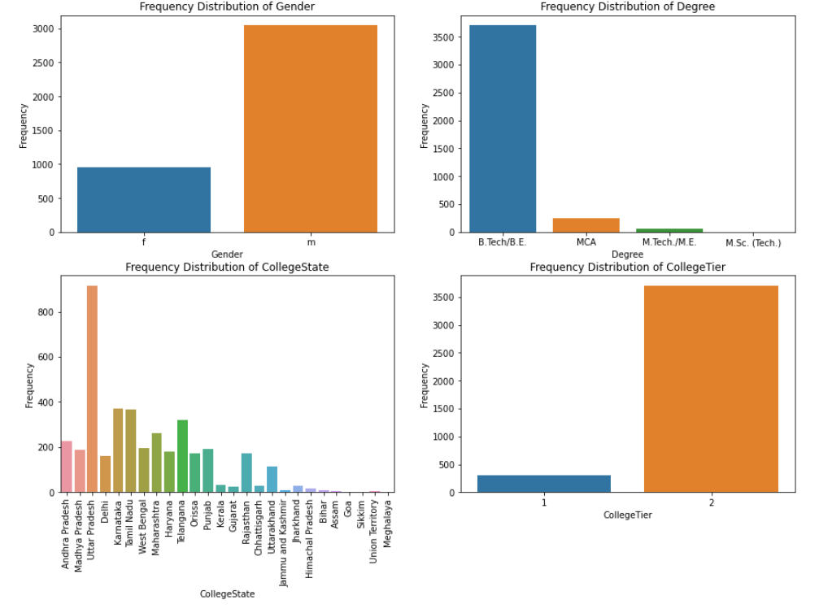
Frequency Distribution Of Each Categorical Variable/Column
Observations:-
Students are mostly Men how and have completed Bachelors of technology or Engineering and most of them are form tire 2 college.
Most Students belongs to Uttar Pradesh, Karnataka, Tamil Nadau, Telangana, Maharashtra and Andhra Pradesh.

Slide 13
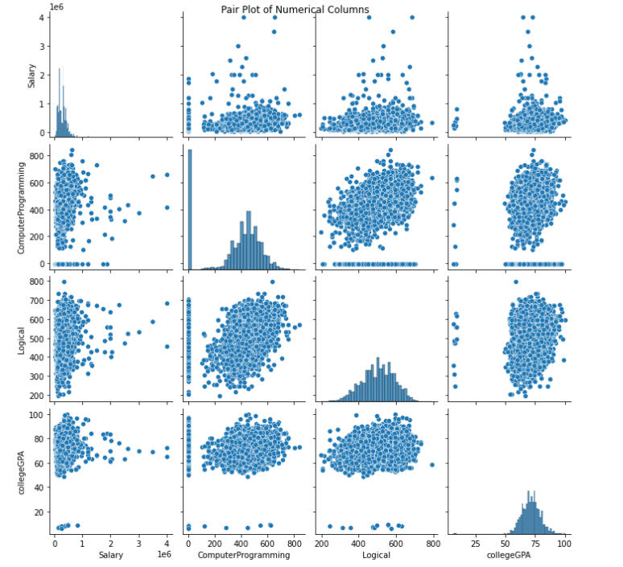
Bivariate Analysis
Observations:-
Students with max CGPA got the maximum Salary.
And some students having less CGPA got high salary packages too.
Above Pair plot shows that there is no referece to the logical and compurter knowledge to get higher salary.

Slide 14
Observations:-
Students are mostly Men how and have completed Bachelors of technology or Engineering and most of them are form tire 2 college.
Most Students belongs to Uttar Pradesh, Karnataka, Tamil Nadau, Telangana, Maharashtra and Andhra Pradesh.

Slide 15
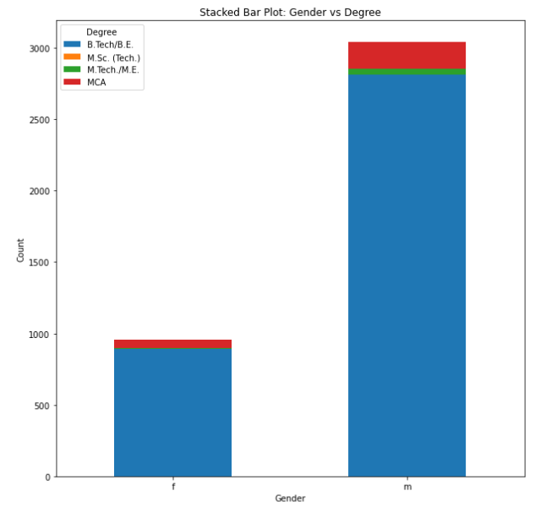
Relationships between categorical and categorical columns
Observations:-
Students are maximum male compare to the female
Both male and female students completed there Batchelor's degree such as B.Tech, B.E .
After Batchelor's most completed Masters.

Slide 16
Research Questions
Times of India article dated Jan 18, 2019 states that “After doing your Computer Science Engineering if you take up jobs as a Programming Analyst, Software Engineer, Hardware Engineer and Associate Engineer you can earn up to 2.5-3 lakhs as a fresh graduate.” Test this claim with the data given to you.
Observation:-
There is no evidence for saying that those who completed Computer Science Engineering if you take up jobs as a Programming Analyst, Software Engineer, Hardware Engineer and Associate Engineer you can earn up to 2.5-3 lakhs as a fresh graduate.

Slide 17
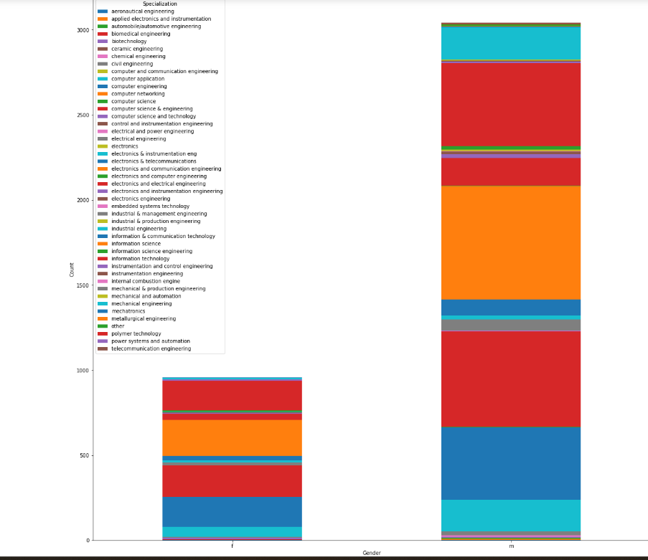
Research Questions
Is there a relationship between gender and specialization? (i.e. Does the preference of Specialisation depend on the Gender?)
Conclusion:-
According to the bar chart there is no such relation between gender and Specialization

Slide 18

THANK YOU

